Slide 1
Non-profit
Organizations
NMD 200-24
By: Aidan Gorneau

Slide 2
Agenda
Non-profit Organizations
1.
Lakes Environmental Assoc.
2.
Quixote Village Tiny Houses
3.
Preble Street Food Pantry
4.
Maine Sea Grant
5.
Bangor Community Garden

Slide 3
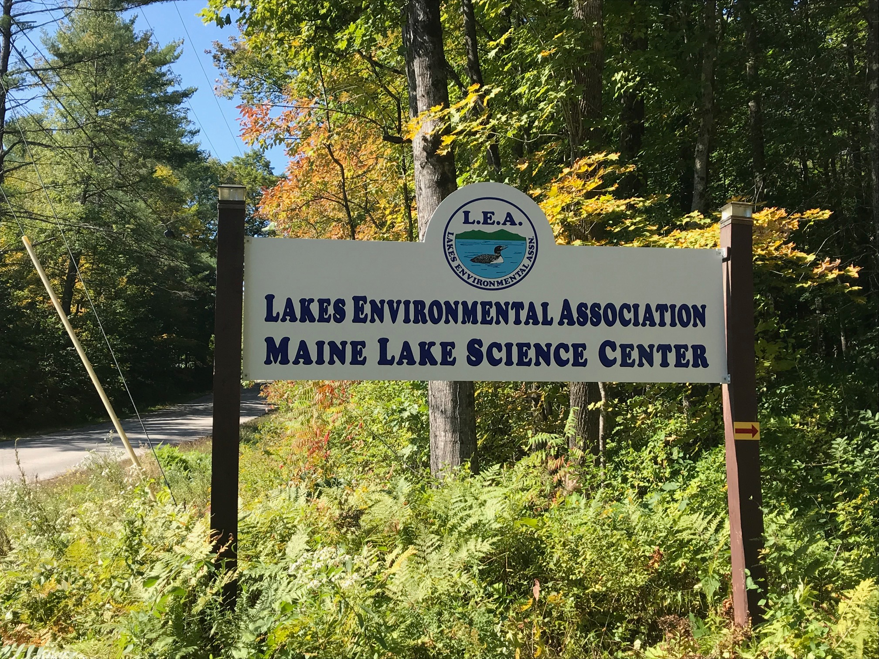
MLEA
Aidan Gorneau
The Maine Lakes Environmental Association (MLEA) is a non-profit organization committed to preserving and protecting the water quality and natural beauty of Maine's lakes. Their main activities include conducting scientific research, advocating for better environmental policies, educating the public about conservation strategies, and promoting sustainable practices among lake users. MLEA collaborates with stakeholders such as local communities, government agencies, and other environmental organizations to achieve its mission.

Slide 4
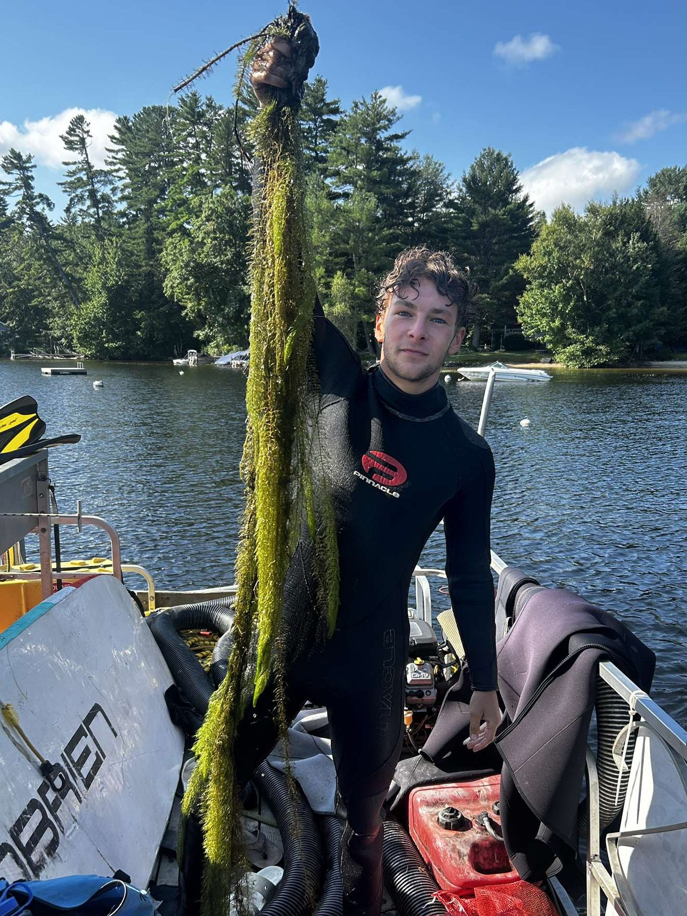
MLEA
Aidan Gorneau
Member Support
Education and Training: MLEA provides members with access to educational materials and training sessions about lake conservation and sustainable practices.
Advocacy: MLEA represents the interests of its members in policy discussions and advocates for regulations that protect the lakes.
Community Engagement: Members have the opportunity to participate in community events and projects, fostering a sense of camaraderie and shared purpose.
Resources: MLEA equips its members with the resources and tools they need to protect their local lakes, such as research data, best practices for lake management, and strategies for community mobilization.

Slide 5
Agenda
Non-profit Organizations
1.
Lakes Environmental Assoc.
2.
Quixote Village Tiny Houses
3.
Preble Street Food Pantry
4.
Maine Sea Grant
5.
Bangor Community Garden

Slide 6
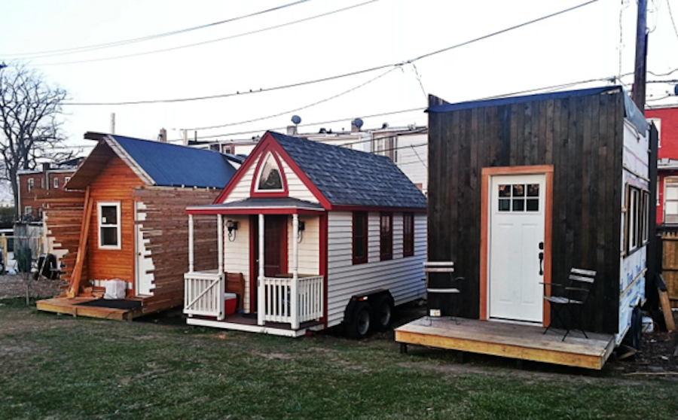
Quixote Village
Aidan Gorneau
Quixote Village provides insights on the concept of tiny house villages, which combine small-scale living with community focus. It highlights the benefits of such communities, such as affordable housing, fostering community, optimizing land use, and shared facilities.
The process of creating a tiny house village involves building a supportive network, identifying suitable land, navigating local building regulations, and securing funding. The article also discusses the type of tiny houses to use, community management issues, and provides advice for those interested in establishing such communities, emphasizing the importance of a sustainable vision and financial model.

Slide 7
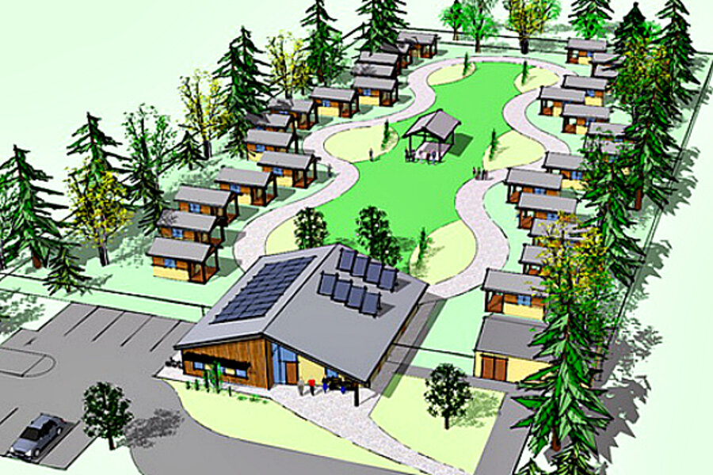
Member Support
Quixote Village
Aidan Gorneau
Affordable Housing: By utilizing small-scale housing, the community can offer more affordable living options.
Community Building: The shared communal spaces and activities foster a sense of community and allow for social interaction, which can lead to improved quality of life.
Shared Resources: The shared facilities reduce the overall cost of living and promote a sustainable lifestyle by minimizing resources and energy use.
Representation: The community can act as a collective to navigate regulatory challenges, negotiate with local officials, and advocate for the interests of its members.
Sustainable Lifestyle: The small-scale living and shared resources of a Tiny House Village promote a lifestyle that is more environmentally friendly and sustainable.

Slide 8
Agenda
Non-profit Organizations
1.
Lakes Environmental Assoc.
2.
Quixote Village Tiny Houses
3.
Preble Street Food Pantry
4.
Maine Sea Grant
5.
Bangor Community Garden

Slide 9
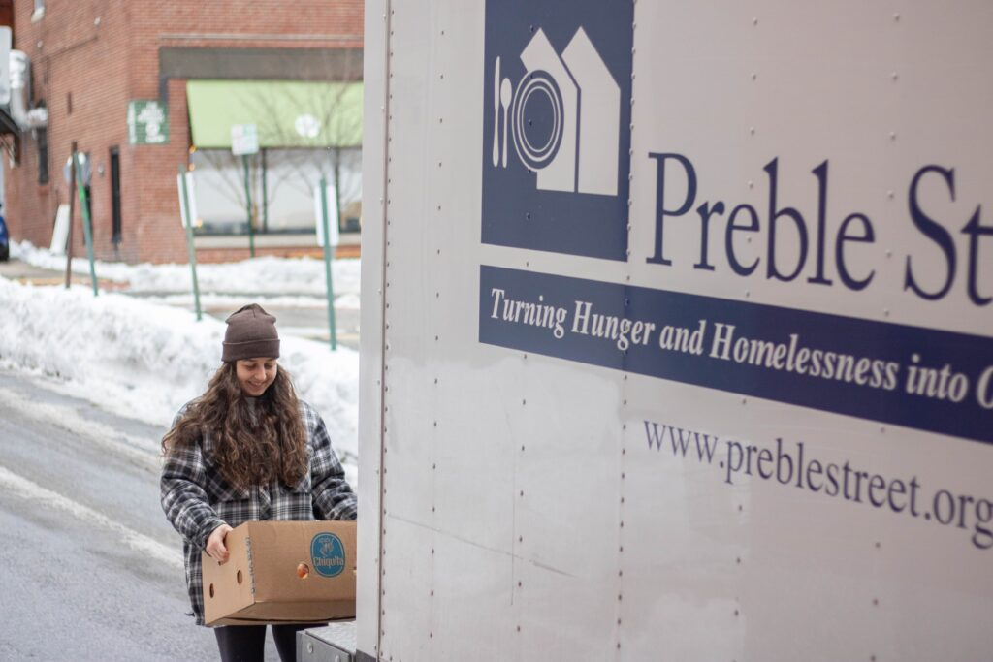
The Preble Street Food Pantry is a vital service located in Portland, Maine, dedicated to providing food assistance to individuals and families facing food insecurity. The pantry operates by collecting food donations from local businesses, farms, individuals, and community-driven food drives. The collected food, which includes fresh produce, dairy, meat, and non-perishable pantry items, is then distributed to those in need.
In some cases, the pantry also organizes food drives and other community initiatives to collect food. It is open at specific hours for people to come and collect food items, adhering to a dignified, customer-choice model which allows those in need to select their own food based on their dietary needs, cooking facilities, and personal preferences.
Preble Street
Aidan Gorneau

Slide 10
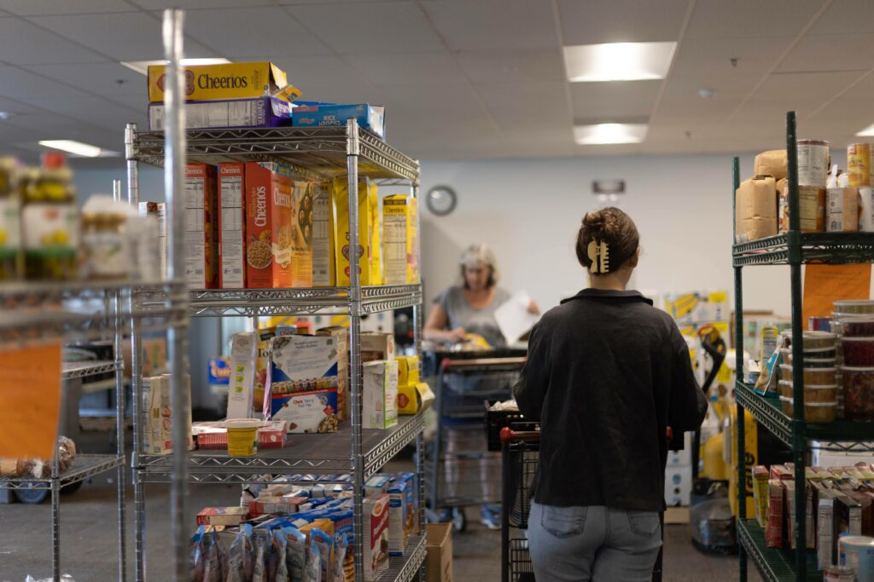
Services Provided
Immediate Food Aid: The pantry provides immediate access to nutritious food for individuals and families facing food insecurity. This assistance is crucial in alleviating hunger and promoting healthful eating habits.
Promotion of Healthy Eating: By offering fresh produce and other nutritious food options, the pantry encourages and enables healthy eating habits among its members.
Advocacy and Support Services: The pantry also advocates for systemic changes to address the root causes of hunger and poverty. It provides support services and resources to help individuals and families navigate these challenges.
Community Connection: By serving as a community hub, the pantry helps foster connections among community members, promoting a sense of support and solidarity.

Slide 11
Agenda
Non-profit Organizations
1.
Lakes Environmental Assoc.
2.
Quixote Village Tiny Houses
3.
Preble Street Food Pantry
4.
Maine Sea Grant
5.
Bangor Community Garden

Slide 12
Sea Grant
Aidan Gorneau
The Maine Sea Grant, hosted by the University of Maine, is part of a national network of 34 NOAA Sea Grant programs focused on marine science. Established in 1971, it aims to address issues of concern to Maine's coastal communities and promote scientific understanding of the state's coastal and marine resources.

Slide 13
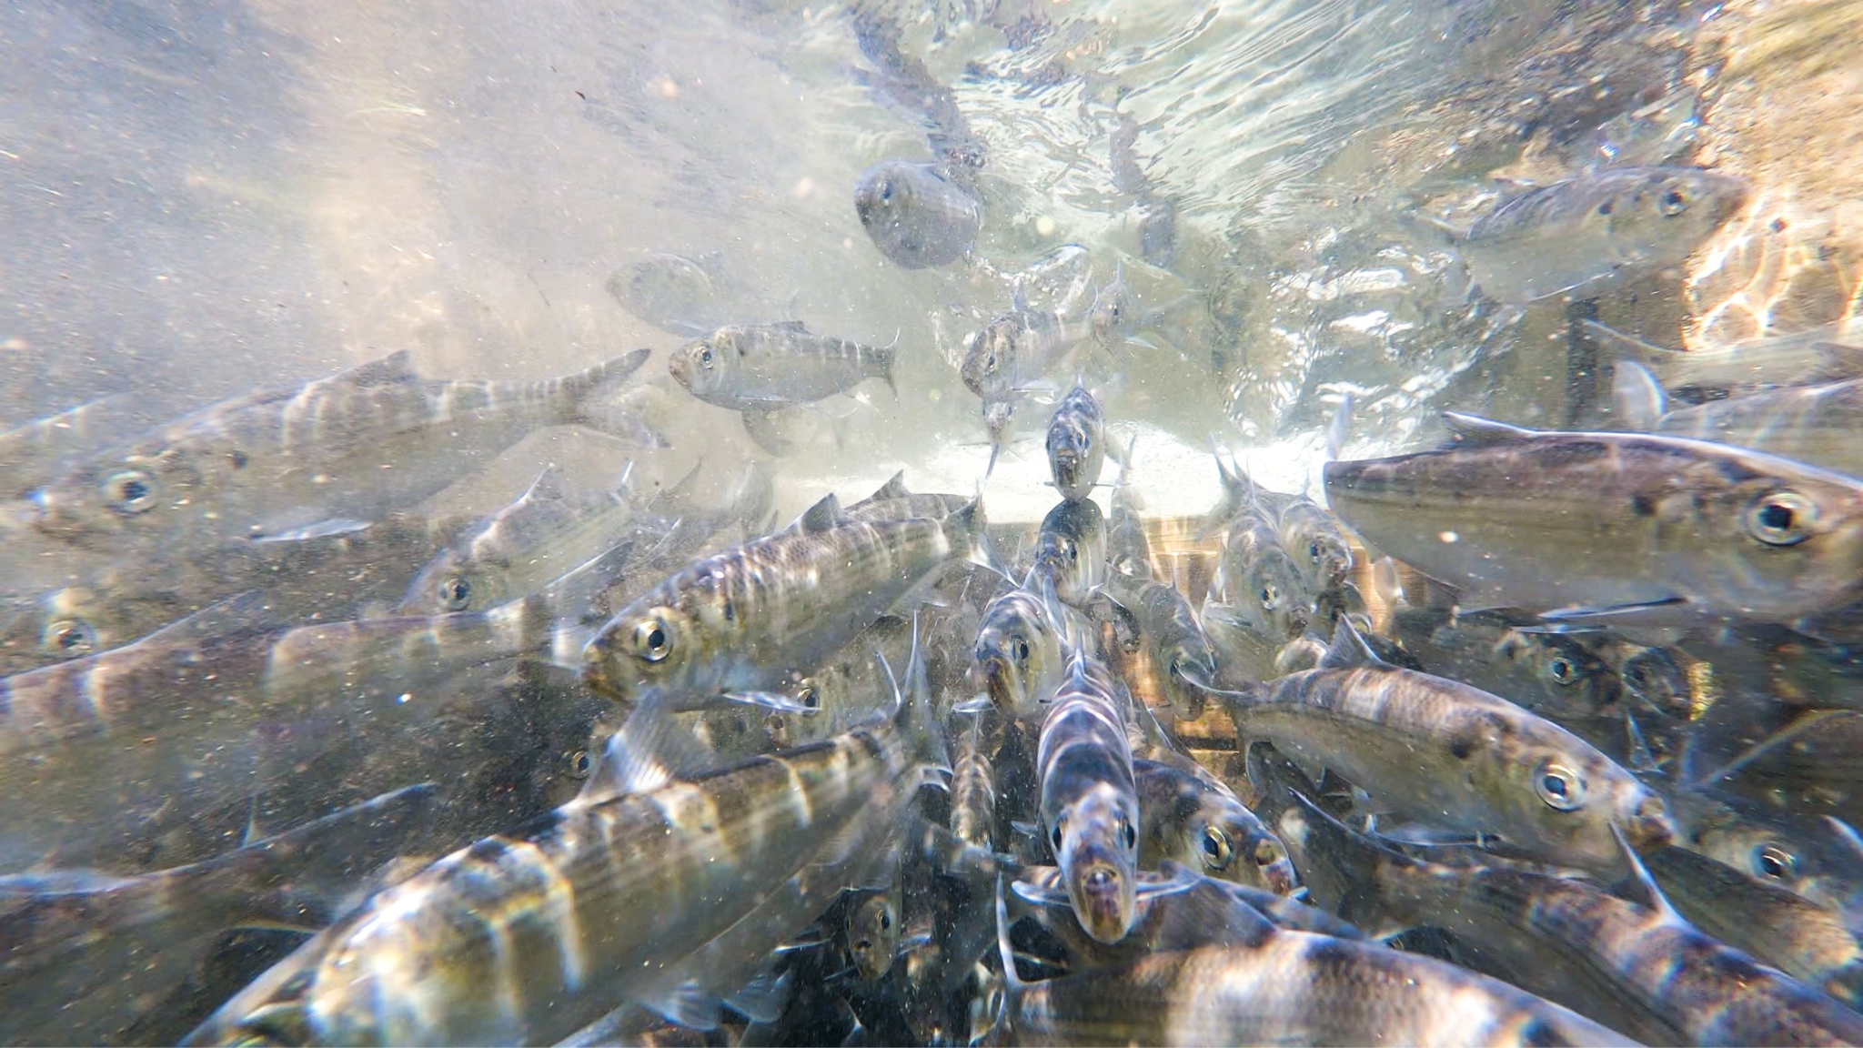
Community Support and Education
Sea Grant
Aidan Gorneau
Research Opportunities: It provides funding opportunities for researchers studying marine science, contributing to the body of knowledge about Maine's coastal and marine resources.
Education and Workforce Development: The program offers educational programs, fellowships, and scholarships to students interested in marine science, helping prepare them for careers in the field.
Advocacy and Representation: The advisory committee represents the interests of various marine coastal stakeholders, ensuring that their needs and concerns are addressed.
Information Sharing: As part of the national Sea Grant network, the Maine Sea Grant program helps share information and solve problems, providing a valuable resource for its members.

Slide 14
Agenda
Non-profit Organizations
1.
Lakes Environmental Assoc.
2.
Quixote Village Tiny Houses
3.
Preble Street Food Pantry
4.
Maine Sea Grant
5.
Bangor Community Garden

Slide 15
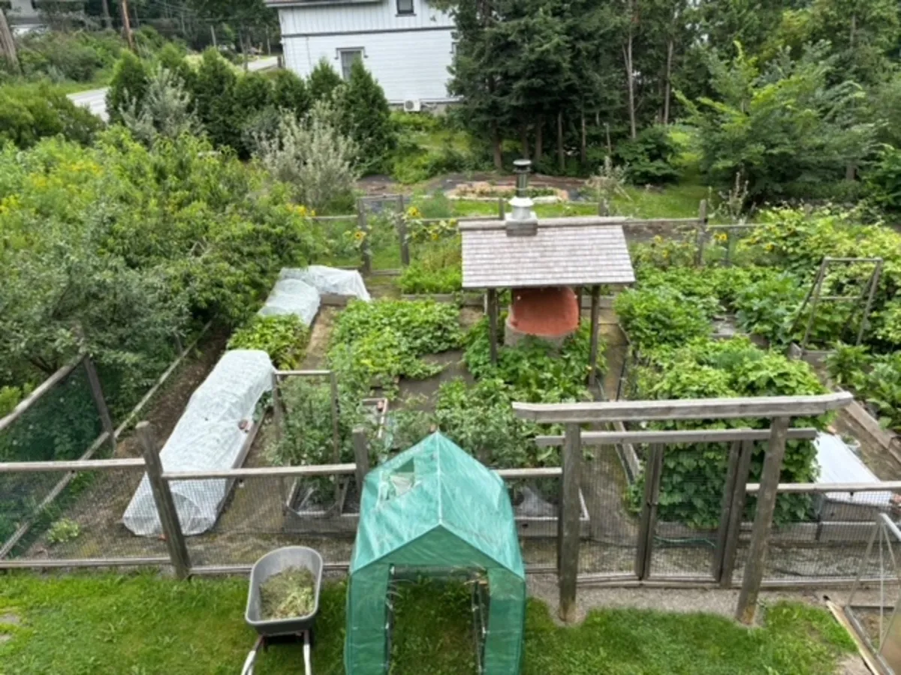
Community Garden
The Bangor Community Garden is a shared space where local residents can nurture and grow their own fruits, vegetables, and other plants. It's a space designed to encourage community participation and interaction, offering a valuable opportunity for residents to engage with their neighbors and address social isolation.
Aidan Gorneau
In the garden, residents rent specific plots where they can plant and tend to their crops. They're responsible for maintaining their individual plots. Unlike collective gardens, where decisions are made as a group, participants in Bangor's community garden tend to the crops in their designated areas only.

Slide 16
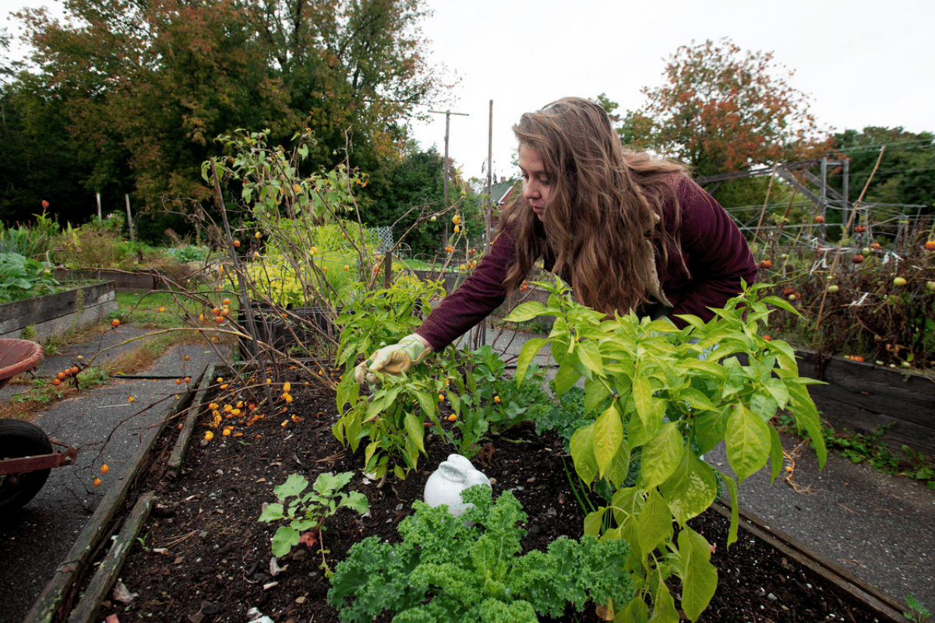
Community Asset
Community Garden
Aidan Gorneau
Access to Fresh Produce: The garden provides an opportunity for residents to grow their own fresh fruits and vegetables which can contribute to a healthier diet.
Community Building: The garden fosters a sense of community among members, providing a space for social interaction and collaboration, enabling neighbors to meet and work together.
Food Security: The Bangor Community Garden plays a role in addressing food insecurity in the local area by providing access to fresh, healthy food.

Slide 17
Drawing
a Conclusion
Drawing a Conclusion
Aidan Gorneau
These examples show thriving alternatives to capitalist, for-profit economic models, which involve mutual benefit, sharing, solidarity, and abundance for all. Each of these organizations are either in our town and community, or activities I would consider joining if they were in our area.

Slide 18
Appendix
Aidan Gorneau
Source
Source
Source
https://mainelakes.org/
https://www.shareable.net/how-to-create-a-tiny-house-village/
https://www.preblestreet.org/what-we-do/food-programs/food-pantry/
Source
Source
Source
https://seagrant.umaine.edu/about/
https://www.bangordailynews.com/2023/04/27/bangor/coe-park-collective-bangor-garden-joam40zk0w/
Nonprofit org image

